Slide 1
Directed Acyclic Graph (DAG)
…and their application to causal inference
Oct 8, 2024

Slide 2
Understanding Causal Pathways
Interested in the effect of Treatment $T$ on outcome $Y$
Treatment affects outcome through mechanism $M$
Observables, $X$, can affect both probability of treatment and outcome
Unobservables, $U$, can affect both probability of treatment and outcome
Other factors, $Z$, affect selection into treatment but not outcome directly

Slide 3
About DAGs…
A DAG is your conceptualization of the data generating process (DGP)
Simplify
Unimportance. if the arrows coming in and out of a variable are likely to be tiny and unimportant effects, we can probably remove the variable.
Redundancy. If there are any variables on the diagram that occupy the same space - we can probably combine them and describe them together.
Mediators. If one variable is only on the graph as a way for one variable to affect another, then we can probably remove it (note, this means removing mechanisms). **
Irrelevance. Some variables are an important part of the data generating process but irrelevant to the research question at hand. If a variable isn’t on any path between the treatment and outcome variables, we can probably remove the variable.
Avoid cycles
Be clear about your assumptions
** I think it’s helpful to identify mechanisms, even if it isn’t traditional in a DAG

Slide 4
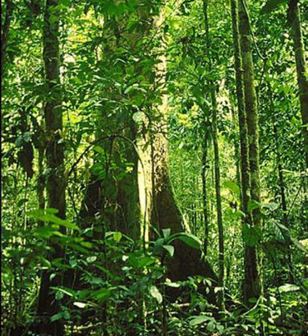
An Example: Agroforestry
Free seedlings $(T)$ create an incentive for households to incorporate trees into agriculture (M), decreasing soil erosion $(Y)$
Adopters have more household labour than those who do $not (X)$
Households who are more concerned about environmental outcomes are more likely to adopt $(U)$

Slide 5
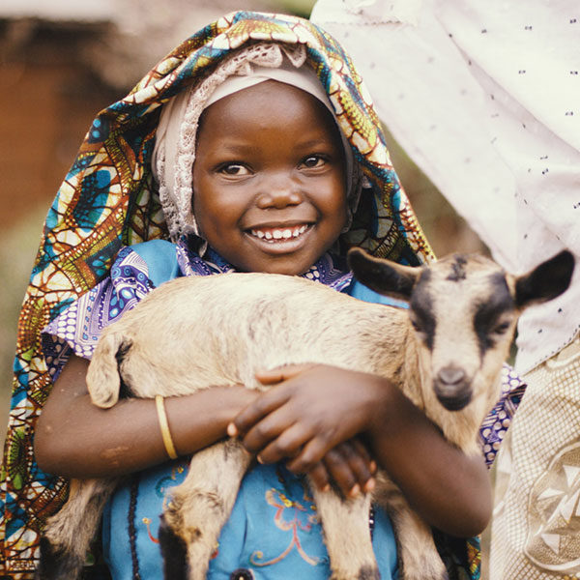
An Example: Livestock
Livestock increases income and reduces cost of animal foods which increase household food security
Households need certain level of assets to care for animals
More nutritionally-minded households may both be more likely to successfully adopt livestock and to better feed their children

Slide 6
Returning to Our Causal Diagram
What would happen if you control for ‘M’ in your regression?
Notes:
e.g. what would happen if you controlled for income in the livestock gift case? Called a ‘Bad control’

Slide 7
Assumptions

Slide 8
SUTVA

Slide 9
Unconfoundedness

Slide 10
Some examples from Development Economics

Slide 11
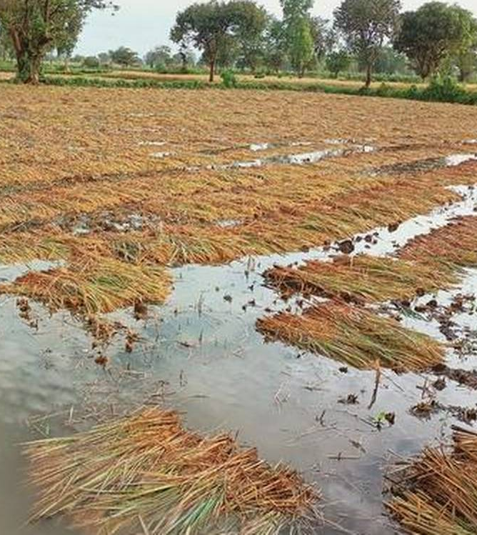
Agriculture
Emerick et al. (2016)
Selected villages in flood-prone Eastern India
Randomly provided some with flood-tolerant rice seed
Those who got seed
Had higher yields when flooding occurred (seeds worked)
Also had higher yields when it didn’t flood (they invested more in their crop knowing it would survive if flooding occurred)

Slide 12
Insurance
Janzen and Carter (2019)
Study index-based livestock insurance (IBLI) in northern Kenya
Use satellites to measure the vegetative cover and predict droughts
Those with livestock in drought area receive insurance payment
Those who got insurance
Had higher levels of consumption
Did not need to sell their assets

Slide 13
Credit
Karlan and Zinman (2010)
Selected South Africans who did not qualify for credit from a bank
Randomly provided some with loans
Those who got loans
Had higher levels of economic self-sufficiency and food consumption
Also were more depressed and had higher levels of stress

Slide 14
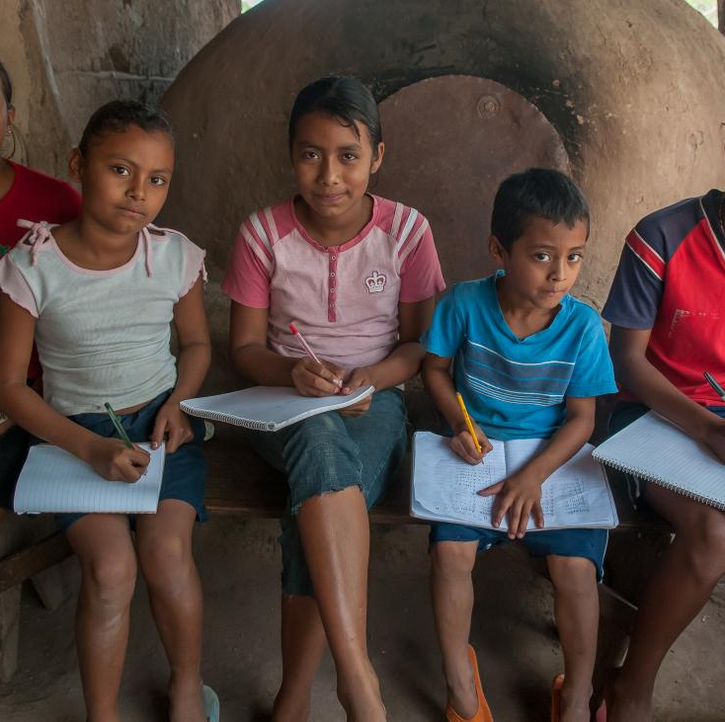
Income & Poverty
CCT – long-term effects (Barham et al., 2019)
Study the impact of a CCT program 10 years later in Nicaragua
Offered CCTs to families with children aged 9-15 for 3 years
Offered CCTs to families with children aged 12-18 for 3 years
10 years later, the younger group had more education and better jobs than the older group

Slide 15
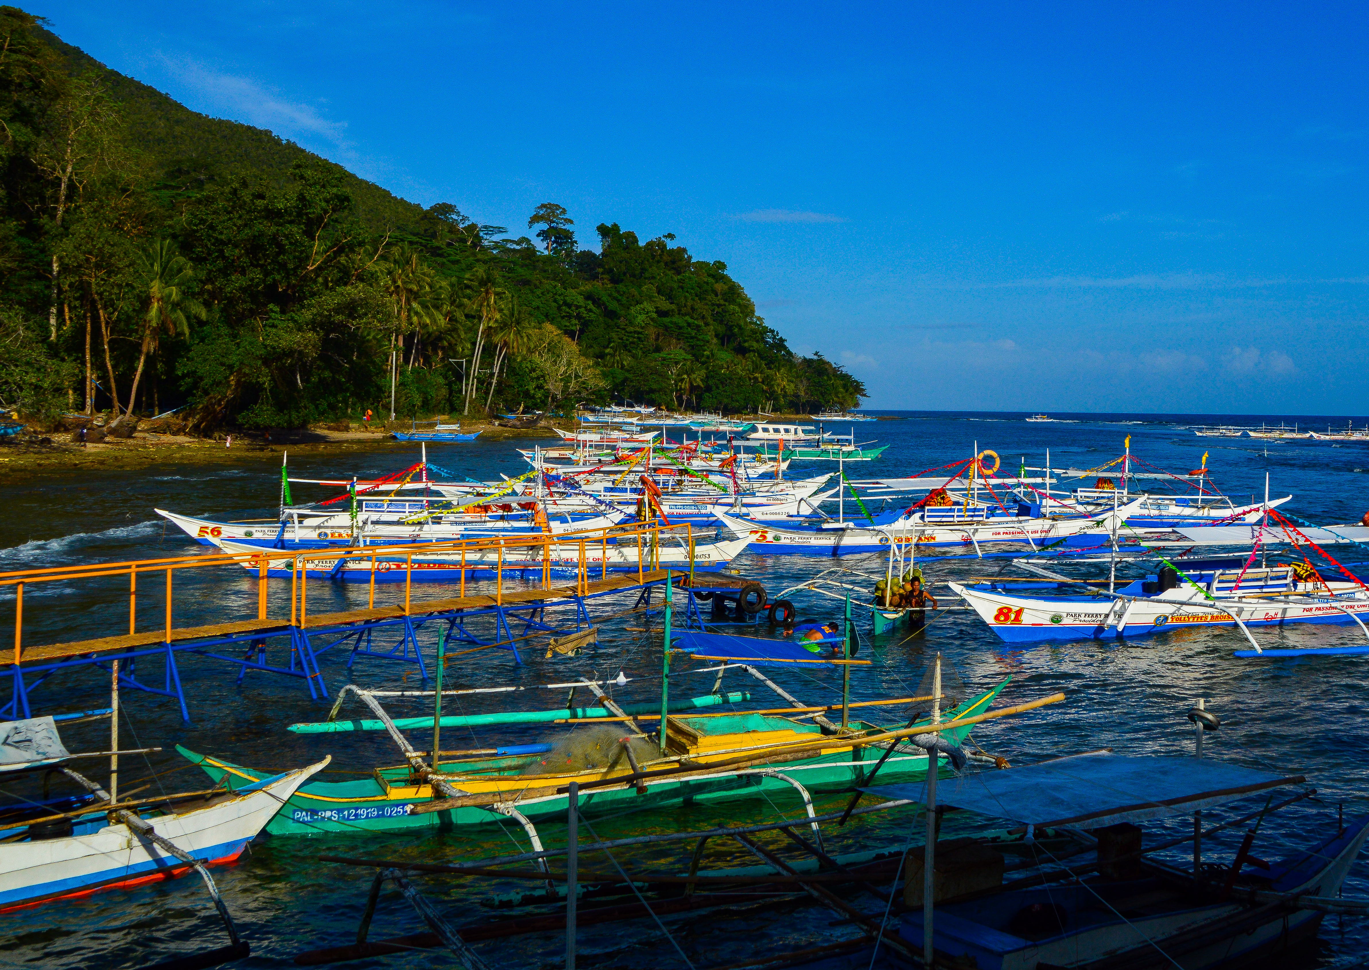
Income & Poverty
CCTs – negative spillovers (Filmer et al., 2023)
Study price effects from a CCT in the Philippines
Provided CCTs to random subset of families with school aged children
CCT families had decreased malnutrition and stunting
Stunting among control families increased!
The influx of money to small villages drove up food prices

Slide 16
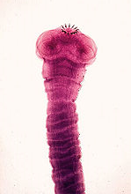
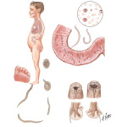
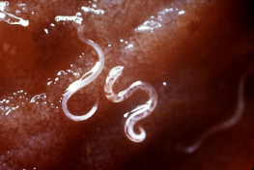
Health and Education
Miguel and Kremer (2004)
Study the impact of providing deworming medication on school attendance and performance
Treated schools “treated” control schools
Those who got treated
Had higher attendance
But not change in test scores

Slide 17
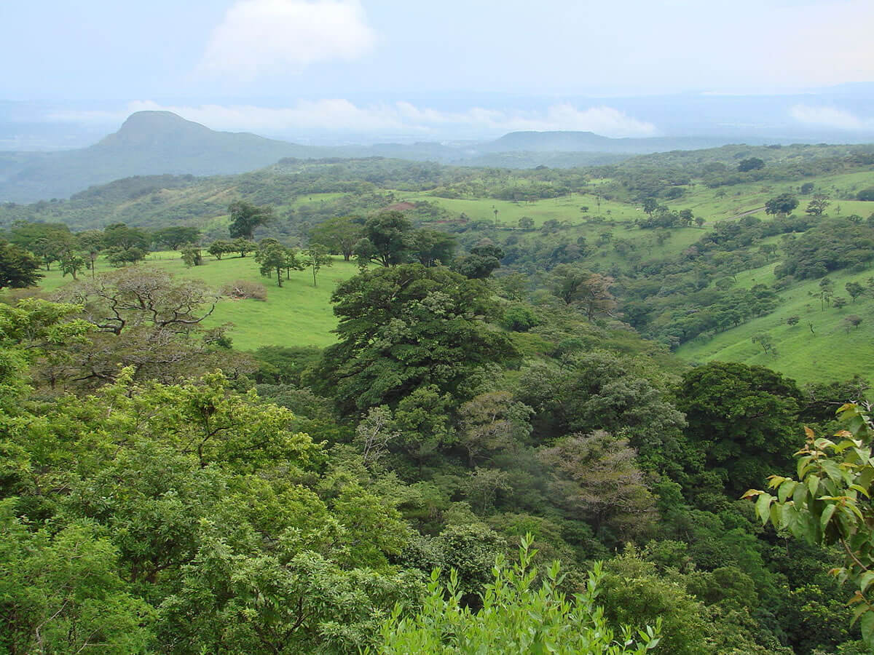
Protected Areas and Income
Ferraro and Hanauer (2014) considered protected areas in Costa Rica
$T$ is protected area status and $Y$ is poverty. $M$’s are (a) ecotourism, (b) ecosystem services (improved), (c) restrictions on land use, (d) infrastructure.
Found 2/3 of income benefit came from tourism. Infrastructure contributed little

Slide 18
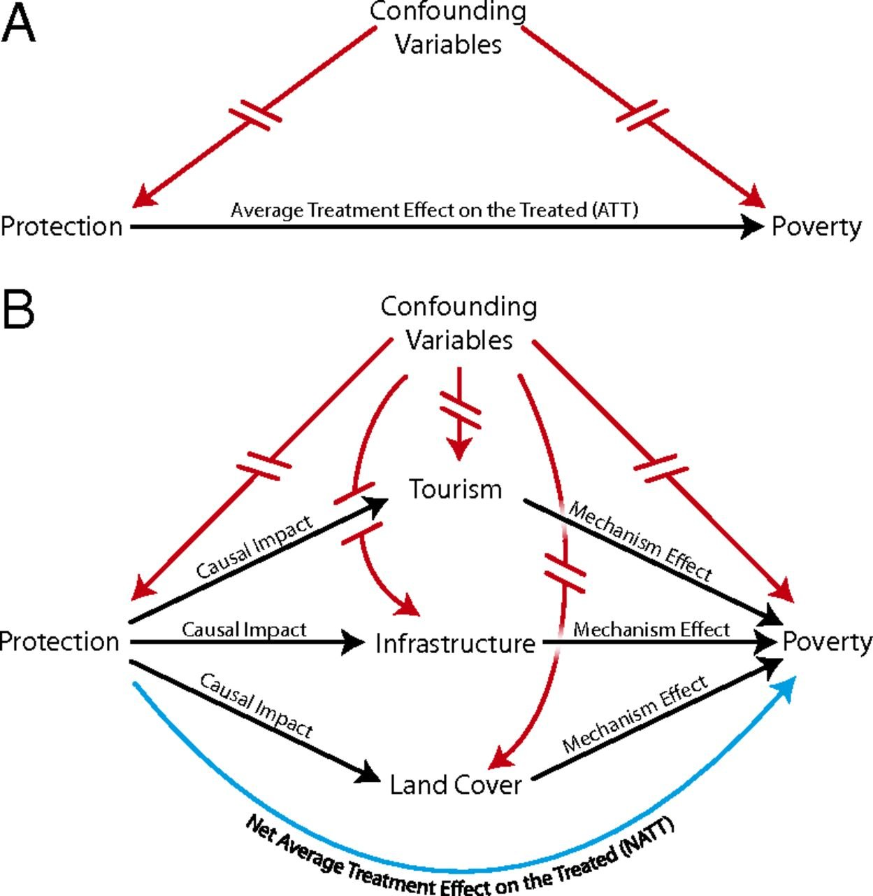

Slide 19
Brodie et al (2023)

Slide 20
Other issues
Treatment Heterogeneity
If treatment only works in some (unknown) circumstances, the results are less useful
Programs can cause their own problems
Effect of being observed
Hawthorne Effect
John Henry Effect
Pygmalion and Golum effect
E.g. monitoring experiment; CT vs CCT
Anticipatory Effect
Change in behaviour induced by potential program introduction

Slide 21
Treatment Estimates of Indonesian Parks

Slide 22
Treatment Estimates of Indonesian Parks

Slide 23
Validity
Internal validity (causal relationship)
Construct validity (measuring treatment and outcome one reports)
External validity (would the results be the same in another place/time?)

Slide 24
References
Tania Barham & Karen Macours & John A Maluccio, (2024). "Experimental Evidence from a Conditional Cash Transfer Program: Schooling, Learning, Fertility, and Labor Market Outcomes after 10 Years," Journal of the European Economic Association, European Economic Association, vol. 22(4), pages 1844-1883.
Kyle Emerick, Alain de Janvry, Elisabeth Sadoulet, and Manzoor H. Dar. (2016). "Technological Innovations, Downside Risk, and the Modernization of Agriculture." American Economic Review, 106 (6): 1537–61.
Paul Ferraro and Merlin Hanauer 2014 “Quantifying causal mechanisms to determine how protected areas affect poverty through changes in ecosystem services and infrastructure” Proc Natl Acad Sci Mar 18;111(11):4332-7. doi: 10.1073/pnas.1307712111
Deon Filmer, Jed Friedman, Eeshani Kandpal, Junko Onishi (2023) “Cash transfers, food prices, and nutrition impacts on ineligible children” Review of Economics and Statistics 105(2): 327-343
Karl Hughes, Seth Morgan, K. Baylis, J. Odoul, E. Smith-Dumont, T.G. Vagen and H. Kegode. 2020. “Assessing the downstream socioeconomic impacts of agroforestry in Kenya.” World Development 128(April) https://doi.org/10.1016/j.worlddev.2019.104835.
Sarah A. Janzen, and Michael R. Carter, (2019), After the Drought: The Impact of Microinsurance on Consumption Smoothing and Asset Protection. American Journal of Agricultural Economics, 101: 651-671. https://doi.org/10.1093/ajae/aay061
Margaret Jodlowski, A. Winter-Nelson, K. Baylis and P. Goldsmith. 2016. “Milk in the Data: Food Security Impacts from a Livestock Field Experiment in Zambia.” World Development 77(January): 99-114.
Dean Karlan, Jonathan Zinman (2009). Observing Unobservables: Identifying Information Asymmetries with a Consumer Credit Field Experiment Econometrica, Vol. 77, No. 6 (Nov., 2009), pp. 1993-2008 (16 pages)
Eduard Miguel and Michael Kremer. (2004), Worms: Identifying Impacts on Education and Health in the Presence of Treatment Externalities. Econometrica, 72: 159-217. https://doi.org/10.1111/j.1468-0262.2004.00481.x

